Slide 1
Computer Generated Landscapes
Tom Arnold

Slide 2
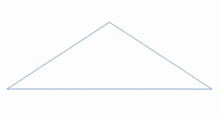
What/Why/How
Generate interesting, dynamic scenes
Simulation, games, movies
Procedural content generation, computer graphics
* https://en.wikipedia.org/wiki/Fractal_landscape

Slide 3
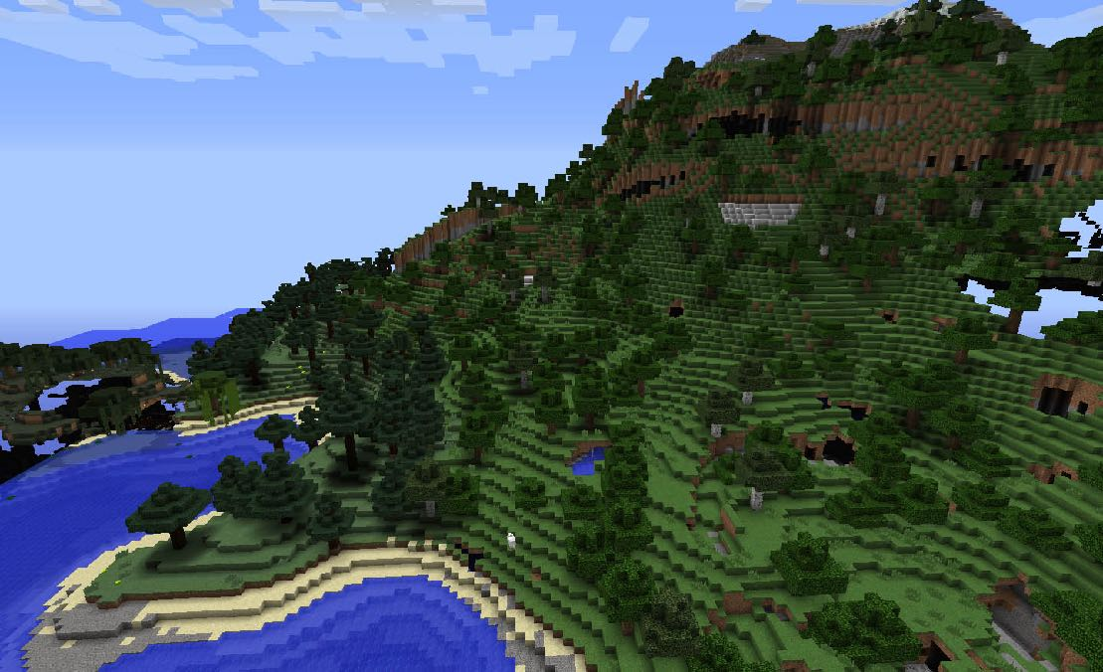
Generating Terrain
“Interesting” terrain
Placing textures/objects in the scene
* Minecraft
Notes:
Terrain needs to have unique landmarks, objects like trees/rivers, etc.

Slide 4
Rendering Terrain
Level of detail
Shadows
* Screenshot of previous project I worked on
Notes:
Algorithms to generate height map that looks like real terrain, e.g. simulated erosion.
Level of detail (LOD) algorithm required to render large terrain in realtime.

Slide 5
Objectives
Interactive WebGL demo
Write-up explaining how everything works
Procedural generation
Rendering
Optimizations
Notes:
Between educational and artistic.

Slide 6
Timeline
Week 6 - Initial skeleton project
Week 8 - Terrain generation algorithm
Week 10 - Terrain LOD renderer
Week 12 - Terrain dynamic lighting
Week 14 - Shadow rendering (terrain and objects in scene)
Other procedural content and simulation aspects will be explored if there is time

Slide 7
Tools
https://threejs.org/ - Javascript 3D Library

